Slide 1



VPNs with OPENVPN & Windscribe
Braxten Loppnow

Slide 2
What is VPN/ (in case you forgot)
VPN stands for Virtual Private Network.
Used as a secure tunneled connection to the internet.
Keeps data and online habits private, mean nobody can see it except you.
Also make it look like device is in a location where it isn’t.

Slide 3
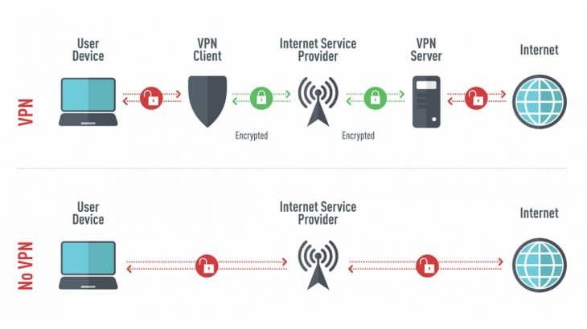
Example Graphic

Slide 4
VPN Services
There are many VPN services out there:
Express VPN, NordVPN, Windscribe, AirVPN, and SurfShark
These all provide many secure “tunnels” to safely browse the internet.
All of these have on main thing in common: OpenVPN

Slide 5
OpenVPN
OpenVPN is an open-source protocol that is used to facilitate a secure tunnel between two points in a network.
While not a VPN service per se, it is utilized by almost every VPN service.
It also uses OpenSSL to help keep connection secure and private.
Also, OpenVPN uses the TLS/SSL protocol and can travel through firewalls and network address translators.

Slide 6
AirVPN
AirVPN is one of many VPN Service providers.
It uses the OpenVPN protocols for its connection, namely OpenVPN UDP, and OpenVPN TCP.
Works on nearly every device, from computer to iPads, to Android phones.

Slide 7
Let’s see how they work with Wireshark…

